Slide 1
Presentation on
Logistic Regression
Presented by
Prof. J. P. Verma
Vice Chancellor
MSc (Stat), PhD, MA(Psychology), Master’s(Computer Application)
Email: vermajprakash@gmail.com
web: jpverma.org
Sri Sri Aniruddhadeva Sports University
(A State University, Govt. of Assam)
Chabua, Dibrugarh, Assam

Slide 2
Logistic Regression
What it is?
A statistical technique of predicting group membership of a dichotomous dependent variable on the basis of independent variables.

Slide 3
Types of Logistics Regression
Binary Logistic Regression
DV is dichotomous
Multinomial Logistic Regression
DV is a classificatory variable having more than two categories.
We develop k-1 models
Example: Body type (Ectomorphic, Mesomorphic, Endomorphic)
Ordinal Logistic Regression
DV is ordinal
We develop one model with different threshold
Example: Predicting years of work experience 1,2,3,4,5

Slide 4
Binary Logistic Regression
What it Does?
It develops a predictive model when the dependent variable is dichotomous variable and independent variables are categorical.

Slide 5
Assumptions about Variables
Dependent Variable
Dichotomous (1,0)
1 : passing in exam, issuing of credit card, success in penalty stroke,
winning in match, passing minimum muscular fitness test
0: Non happening of event
Independent Variable
Continuous
Can be ratio, interval, or mix of metric or non-metric

Slide 6
What we do in Logistic Regression?
Probability, p
(dependent variable takes value 1 rather than 0)
We develop a model
for
on the
Independent variables
predicting
basis of

Slide 7

Predicting probability p
Can p be the linear function of independent variables ?
Due to large number of IVs the p may exceed 1 which is not permissible.
What to do ?

Slide 8
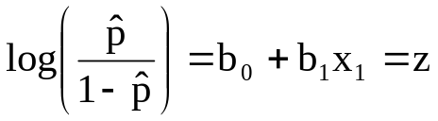
Predicting the probability p in Logistic Regression?
Instead of p
Log(Odds) is predicted
On the basis of IVs
Log(Odds) or Logit
Probability, p is predicted by knowing Log(Odds)

Slide 9
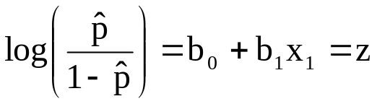
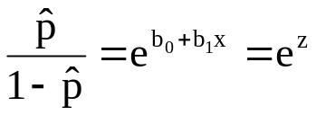
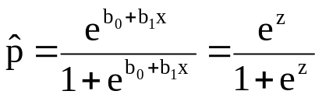

Predicting p with Log(Odds)
By knowing z the probability can be estimated

Slide 10



Advantage of using Log(Odds) function
1
0.5
p
-
0
+
z
Whatever may be the value of Z, the p will vary between 0 and 1

Slide 11

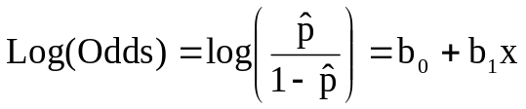
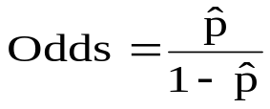
Regression analysis Vs Logistic regression
Simple Regression
Logistic Regression
For each unit increase in x, the y increases by b₁ units
For each unit increase in x, the Log(Odds) increases by ‘b₁’ units.
Or
Example: y= 2+3x
x y
1 5
2 8
3 11
4 14
increases by Exp(b₁)

Slide 12
Application of Logistics Regression
Predicting success in exam
Predicting obesity
Predicting health status
Predicting success in penalty kick in hockey on the basis of IVs such as speed of the hit, player’s height, accuracy, arm strength and eye hand coordination etc.
Predicting winning in football match on the basis of IVs like number of passes, number of turnovers, penalty yardage, fouls committed etc.
Finding likelihood of a particular horse finishing first in a specific race.

Slide 13
Assumptions in Logistics Regression
More Flexible Technique
The DV should be binary for binary logistics and multiclass classification for multinomial logistic regression
Logistic Regression assumes a linear relationship between the continuous IVs and the link function (logit)
Independence of observation. No repeated measures.
No multicollinearity
Makes no assumption about the nature of relationship between IVs and DV
IVs are not required to be normally distributed but the power of analysis increases if IVs are normally distributed
At least 10 sample per independent variable required

Slide 14
Steps in Logistic Regression
1. Define code dependent variable
1 : occurrence of an event
0 : otherwise
2. Define Code for categorical IVs
Code may be 0,1,2 or any sequence
Lowest code is selected as reference category in SPSS

Slide 15
Steps in Logistic Regression
3. Use SPSS/R to generate the following output
Coding of dependent and independent variables
Omnibus Tests of Model Coefficients
Model Summary
Hosmer and Lemeshow Test
Classification Tableª
Variables in the equation
Variables not in the equation

Slide 16
Steps in Logistic Regression
4. Develop logistic regression equation
using regression coefficient of the variables
selected in the model for predicting log(odds)
5. Report the findings using Exp(B)

Slide 17
Logistic Regression- A Solved Example
Purpose: Predicting success in basketball match
______________________________________
Match Result Number Free Offensive Blocks
of Pass throws rebound
_______________________________________________________
1 1 0 1 1 1
2 0 1 0 0 0
3 1 0 1 1 0
4 1 1 0 0 1
5 0 1 1 1 0
6 0 0 0 0 1
7 1 1 0 1 0
8 0 0 1 0 1
9 1 1 0 1 1
10 0 1 1 0 0
11 1 0 0 1 0
12 0 1 0 0 1
13 1 1 1 1 0
14 0 0 0 0 1
15 1 1 1 1 0
16 0 0 0 1 1
17 0 1 1 0 0
18 1 0 0 1 1
19 0 1 1 0 0
20 1 0 0 1 0
21 0 1 1 0 1
22 1 0 0 1 1
________________________________________________________
Dependent Variable
Result in Basketball Match:
1: Win
0:Loose
Independent Variable
Number of Pass : 0 = lower 1 = higher
Offensive rebound : 0 = lower 1 = higher
Free throws : 0 = lower 1 = higher
Blocks : 0 = lower 1 = higher
Team having average number of pass less than the opponent is coded as 0 and the other as 1
Similar coding for other variables
Output Slide

Slide 18
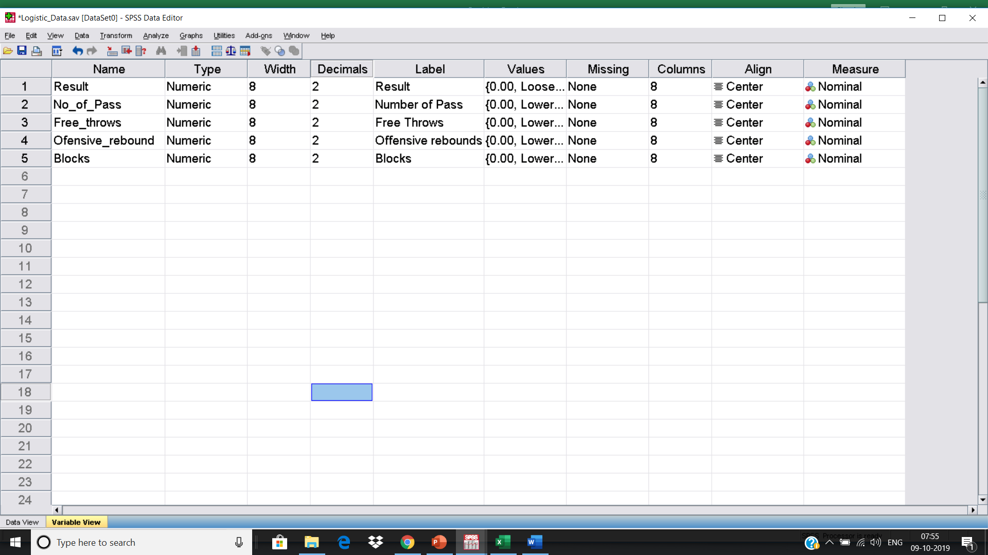
Defining Variables in SPSS

Slide 19
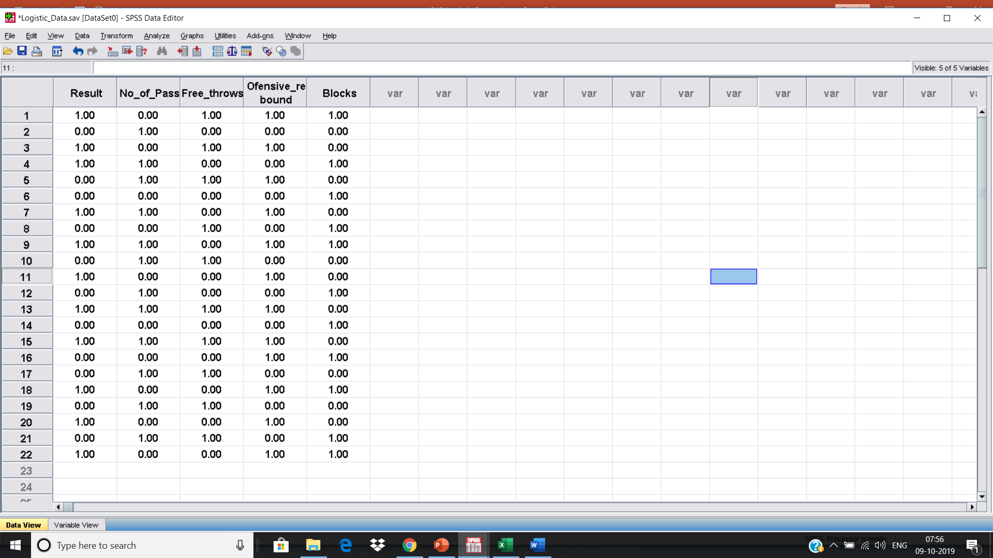
Data file in SPSS

Slide 20
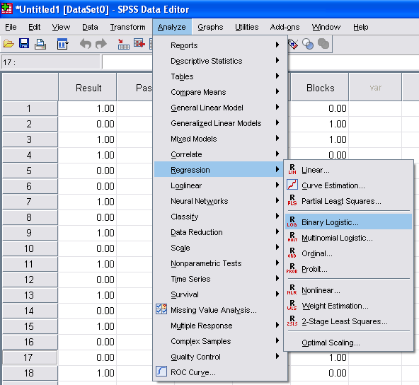
SPSS commands for Logistic Regression
Analyze Regression Binary Logistic

Slide 21
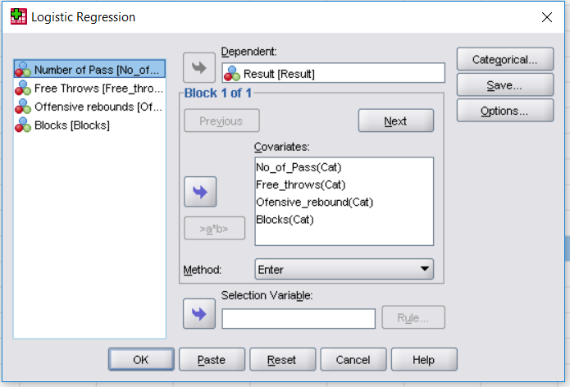
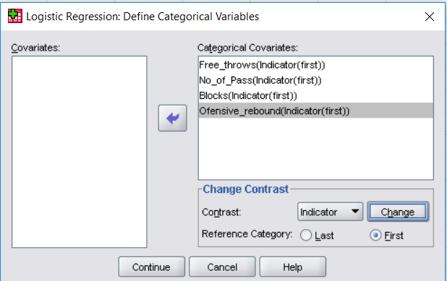
Variable Selection
Transfer DV into “Dependent” Section
Transfer IVs into “Covariates” Section
Shift all categorical IVs into “Categorical Covariates”
Indicator is a type of contrast we wish to use it.
It contrasts the presence of a category with its absence
Select First and press Change for SPSS to know that the first category is the reference category
Click on Continue for further option

Slide 22
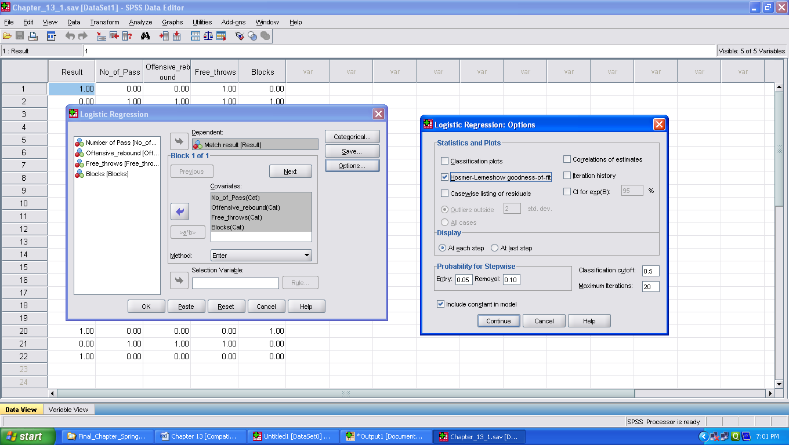
Selecting Options for Outputs
Check option ‘Hosmer-Lemshow goodness-of-fit’
Hosmer-Lemeshow Test
It tests the null hypothesis that whether the predicted probabilities math the observed probabilities.
Classification cutoff
If a case has .5 or more probability of being in the target group (based on model) it is classified in the target group

Slide 23
SPSS Outputs - Case Processing and Coding Summary
Table 1 Case Processing Summary
______________________________________________________________
Unweighted Casesª N Percent
______________________________________________________________
Selected Cases Included in Analysis 22 100.0
Missing Cases 0 .0
Total 22 100.0
Unselected Cases 0 .0
Total 22 100.0
______________________________________________________________
a. If weight is in effect, see classification table for the total number of cases.
Table 2 Dependent Variable Encoding
________________________________________
Original Value Internal Value
________________________________________
Loosing 0
Winning 1
___________________________________

Slide 24
SPSS Outputs - Coding for Categorical IVs
Table 3 Categorical Variables Coding
___________________________________________________
Parameter coding
Frequency (1)
___________________________________________________
Blocks Lower 11 0
Higher 11 1
Free_throws Lower 10 0
Higher 12 1
Offensive_rebound Lower 12 0
Higher 10 1
Number of pass Lower 10 0
Higher 12 1
____________________________________________
Original Coding

Slide 25
Analyzing SPSS Outputs in Logistic Regression
SPSS/R generates outputs in two section
Block 0: Logistic Model without Predictors
Block 1: Logistic Model with Predictors

Slide 26
Block 0: Logistic Model without Predictors
Table 4 Classification Table^{a,b} (model without predictors)
______________________________________________________________
Predicted
Match result % Correct
Observed Loosing Winning
_____________________________________________________________
Step 0 Match result Loosing 0 11 .0
Winning 0 11 100
Overall Percentage 50.0
_____________________________________________________________
        a. Constant is included in the model
        b. The cut value is .500
Remark
Without adding any IV 50% correct classification can be achieved
The odd ratio shown as Exp(B), has a value of 1.000
This is because 11(winning) is 1 times as large as 11(loosing)
The odd ratio inform us that a random selected team is 1 times as likely to be the winner as not
Variables in the Equation
_________________________________________________________
B S.E. Wald df Sig. Exp(B)
_________________________________________________________
Step 0 Constant .000 .426 .000 1 1.000 1.000
_________________________________________________________
Exp(B) = 11(winning)/11(loosing) = 1

Slide 27
Block 0: Logistic model without predictors
Table 5 Variables not in the Equation
_____________________________________________________________________
Score(Chi square) df Sig.
_____________________________________________________________________
Step 0 Variables No_of_Pass(1) .733 1 .392
Free_throws(1) .733 1 .392
Offensive_rebound(1) 11.733 1 .001
Blocks(1) .182 1 .670
Overall Statistics 12.152 4 .016
______________________________________________________________
Conclusion
Only Offensive rebound is significant

Slide 28
Block 1: Logistic Model with Predictors
Testing significance of the model
Table 6 Omnibus Tests of Model Coefficients
_______________________________________
Chi-square df Sig.
_______________________________________
Step 1 Step 14.102 4 .007
Block 14.102 4 .007
Model 14.102 4 .007
_______________________________________
It tests the Null hypothesis that all the predictor’s coefficients are zero
Degrees of freedom is 4 as there are four predictors
Three Indices for Model Fit
-2LL (deviance statistic:), used for comparing model, lesser the value better the model(how for predicted p differs with actual p)
Cox& Snell Square – pseudo R²
Nagelkere square –pseudo R² . Suggests that 63.1% of the variance associated with the DV is explained by IVs in the model.
Table 7 Model Summary(deviance statistic)
____________________________________
Step -2 Log Cox & Snell R Nagelkerke R
likelihood Square Square
________________________________________
1 16.397ª .473 .631
____________________________________
Estimation terminated at iteration number 5 because
parameter estimates changed by less than .001.

Slide 29
Testing Goodness of Fit of the Model
Testing significance of the model
Table 8 Hosmer and Lemeshow Test
__________________________________
Step Chi-square df Sig.
1 4.174 7 .760
__________________________________
Hosmer and Lemeshow Test
A formal test which test the Null hypothesis that predicted and observed probabilities are same
For model to be good chi square should not be significant(p > .05)
subgroups are usually formed by dividing the predicted probabilities into 10 deciles

Slide 30
Classification Table for Model Accuracy
Table 4 Classification Tableª (model with predictors)
______________________________________________________________
Predicted
Match result % Correct
Observed Loosing Winning
_____________________________________________________________
Step 1 Match result Loosing 9 2 81.8
Winning 1 10 90.9
Overall Percentage 86.4
_____________________________________________________________
        a. The cut value is .500
Interpretation
By including all IVs in the model correct classification increases to 86.4%.

Slide 31
Developing logistic model
Partial regression coefficients
Indicates amount of change in log odds if category of predictor variable is changed
Indicates amount of change in odds ratios if category of predictor variable is changed
Table 11.12 Variables in the Equation
B S.E. Wald df Sig. Exp(B)
Step 1ª No_of_Pass(1) .688 1.527 .203 1 .652 1.989 Free_throws(1) -1.192 1.444 .681 1 .409 .304
Offensive_rebound(1) 4.223 1.638 6.644 1 .010 68.269
Blocks(1) .234 1.539 .023 1 .879 1.263
Constant -2.382 2.149 1.228 1 .268 .092
a. Variable(s) entered on step 1: No_of_Pass, Free_throws, Offensive_rebound, Blocks
$$\log{\frac{p}{1−p}}=−2.382+0.234×Blocks+4.223×Offensive_{rebound}−1.192×Free_{throws}+0.688×No_pass$$
Interpretation
Odds of the team [having higher offensive rebound(being focal category)] winning the match are 68.269 times the odds of the team(having lower offensive rebound [being reference category)] winning, controlling for other variables.
Larger the odds ratio, more is the predictive value of the associated IV

Slide 32
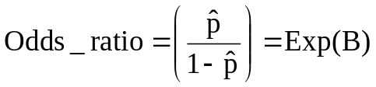
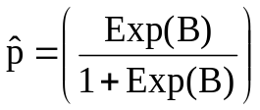


Odds ratios and logistic model
Explanation
Offensive_rebound
0 = lower (reference category)
1 = higher (focal category)
Table 11.12 Variables in the Equation
_______________________________________________________________________
B S.E. Wald df Sig. Exp(B)
_______________________________________________________________________
Step 1ª No_of_Pass(1) .688 1.527 .203 1 .652 1.989 Free_throws(1) -1.192 1.444 .681 1 .409 .304
Offensive_rebound(1) 4.223 1.638 6.644 1 .010 68.269
Blocks(1) .234 1.539 .023 1 .879 1.263
Constant -2.382 2.149 1.228 1 .268 .092
_______________________________________________________________
a. Variable(s) entered on step 1: No_of_Pass, Free_throws, Offensive_rebound, Blocks
For Offensive rebound
Interpretation: If offensive rebound of the team is higher than the opponent, probability of winning that team becomes .985 if other variables are constant.

Slide 33
Logistic Regression with R Software
Illustration
Data on Risk Age and Gender
_________________________
riskaverse age gender
_________________________
1 45 1
0 25 0
0 20 1
1 50 1
0 25 1
1 37 0
1 43 1
0 30 1
1 49 1
0 30 0
1 54 0
1 59 1
0 29 0
1 55 0
1 59 1
0 29 1
0 45 0
0 30 0
1 65 1
1 72 1
_________________________
Install.packages(“FAMILY”)
library(FAMILY)
Date file in data.frame format
riskaverse<-c(1,0,0,1,0,1,1,0,1,0,1,1,0,1,1,0,0,0,1,1)
age<-c(45,25,20,50,25,37,43,30,49,30,54,59,29,55,59,29,45,30,65,72)
gender<-c(1,0,1,1,1,0,1,1,1,0,0,1,0,0,1,1,0,0,1,1)
riskd<-data.frame(riskaverse,age,gender)

Slide 34
To Estimate Logistic Regression
Commands
model.full <- glm(riskaverse ~ age + gender, data = riskd, family = binomial() )
summary(model.full)
Output
Call:
glm(formula = riskaverse ~ age + gender, family = binomial(), data = riskd, )
Deviance Residuals:
Min 1Q Median 3Q Max
-1.62552 -0.25911 0.01548 0.20786 1.76361
Coefficients:
Estimate Std. Error z value Pr(>|z|)
(Intercept) -12.0886 5.2716 -2.293 0.0218 *
age 0.2911 0.1265 2.300 0.0214 *
gender 1.4266 2.0606 0.692 0.4887
-----
Signif. codes: 0 ‘***’ 0.001 ‘**’ 0.01 ‘*’ 0.05 ‘.’ 0.1 ‘ ’ 1
(Dispersion parameter for binomial family taken to be 1)
Null deviance: 27.5256 on 19 degrees of freedom
Residual deviance: 7.1679 on 17 degrees of freedom
AIC: 13.168
Number of Fisher Scoring iterations: 7
Findings:
Gender is not significant

Slide 35
Reduced Model After removing Gender
Commands
model.redu<-glm(riskaverse~age, data=riskd, family=binomial()) summary(model.redu)
Output
Call:
glm(formula = riskaverse ~ age, family = binomial(), data = riskd)
Deviance Residuals:
Min 1Q Median 3Q Max
-1.9453 -0.3116 0.0210 0.1882 1.4567
Coefficients:
Estimate Std. Error z value Pr(>|z|)
(Intercept) -11.5734 5.1305 -2.256 0.0241 *
age 0.2956 0.1286 2.299 0.0215 *
---
Signif. codes: 0 ‘***’ 0.001 ‘**’ 0.01 ‘*’ 0.05 ‘.’ 0.1 ‘ ’ 1
(Dispersion parameter for binomial family taken to be 1)
Null deviance: 27.5256 on 19 degrees of freedom
Residual deviance: 7.6798 on 18 degrees of freedom
AIC: 11.68
Number of Fisher Scoring iterations: 7

Slide 36
Comparing Full model and Reduced Model
H₀ : Reduced model is true
a p-value <.05 will reject the H₀
We wish not to reject the H₀
Command
anova(model.redu, model.full, test="Chisq")
Output
Analysis of Deviance Table
Model 1: riskaverse ~ age
Model 2: riskaverse ~ age + gender
Resid. Df Resid. Dev Df Deviance Pr(>Chi)
1 18 7.6798
2 17 7.1679 1 0.51197 0.4743
Result: Since chi-square is nonsignificant hence model with one predictor fits the data better than the full model.

Slide 37
To Find Regression Coefficients
Command
coef(model.redu)
Output
P= probability of risk averse
Log(p/(1-p)) = -11.5734 +.2956(age)
(Intercept) age
-11.5734275 0.2956037
Finding p if age=40:
We need to wrap the data of age inside the data frame riskd
Command
newdata=data.frame(age=40)
predict(model.redu, newdata, type="response")
Output
Inference: For a person age 40, the probability of being risk averse is about 56.23%
1
0.5623541

Slide 38
Checking Model Fit
To check how well Our model fits.
In reduced model indices of fit are shown : Null and deviance residual and AIC (Akaike Information Criteria)
AIC: Lesser the value better is the model.
Test Statistic: Difference between the residuals deviance for the model with predictors and without predictors
Command with(model.redu, null.deviance-deviance)
Output [1] 19.84571
For df
Command with(model.redu, df.null-df.residual)
Output [1] 1
For p-value
Command with(model.redu, pchisq(null.deviance - deviance, df.null –
df.residual, lower.tail = FALSE))
Output [1] 8.395082e-06
Inference: Since Chi-square of 19.85 with 1 df and associated p <.001, tells us that our model as a whole fits significantly better than an empty model.

